Slide 1
Python week 7
Canberra Chinese School Sem2

Slide 2

Review(Lists)
A list is a box that stores multiple variables.
A list starts with the 0th element. The first element in a list is the 0th, not 1st
Thus, the first element is denoted the index 0 element.
The second element is the index 1 element.
And so on.

Slide 3
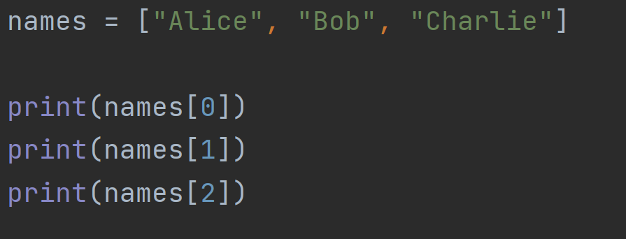
Review(Lists)
names[n] denotes the index n element, or the
(n+1)th element in the list

Slide 4
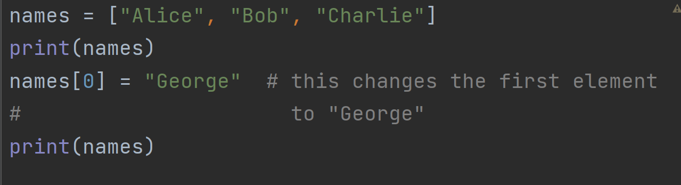
Review(Lists)
You can change the first element of the list like this.

Slide 5
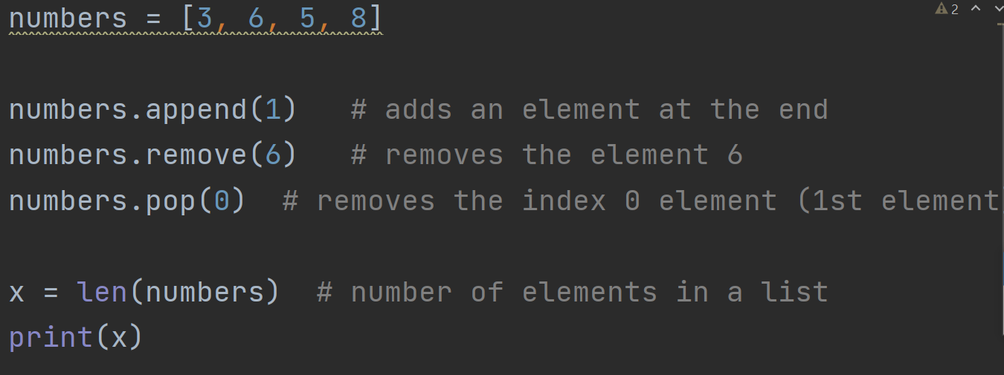
Review Lists operations

Slide 6

Quiz 1
Answer: D
What is
A. “e”
B. “cloudy”
C. “weather2”
D. “rainy”

Slide 7


Quiz 2
Answer: “door”
What is
What is
Answer: doesn’t exist

Slide 8
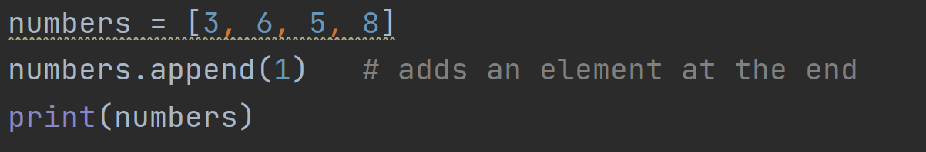
Quiz 3
Answer: B
What will be printed?
A. 1, 3, 6, 5, 8
B. 3, 6, 5, 8, 1
C. 3, 6, 5, 8, 3
D. 3, 6, 5, 8, 3, 6, 5 ,8

Slide 9
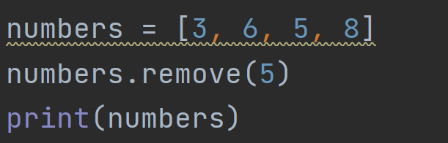
Quiz 4
What will be printed?
Answer: 3, 6, 8

Slide 10
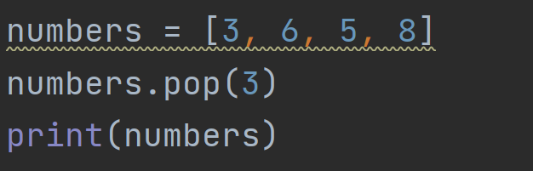
Quiz 5
What will be printed?
Answer: 3, 6, 5

Slide 11
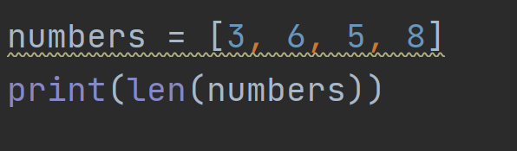
Quiz 6
What will be printed?
Answer: 4

Slide 12


List Algorisms
Suppose we are given a list
How do we use an algorithm to find the largest integer of this list?

Slide 13
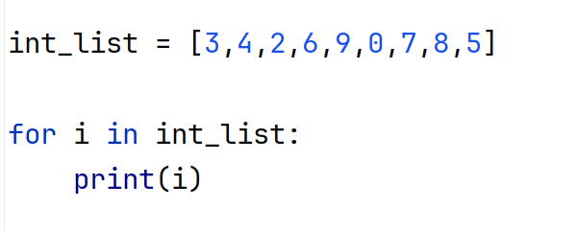
List Algorisms
Let’s try this:
This prints every number from this list. Now we just need to compare them and find the largest.

Slide 14
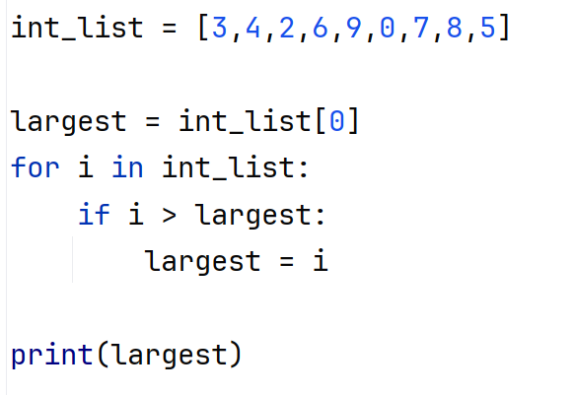
List Algorisms

Slide 15
List Algorisms
Question: can we make a function that takes in a list, and find the maximum number of that list?

Slide 16

List Algorisms
Question: can we make a function that takes in a list, and find the maximum number of that list?
Let’s define a function

Slide 17
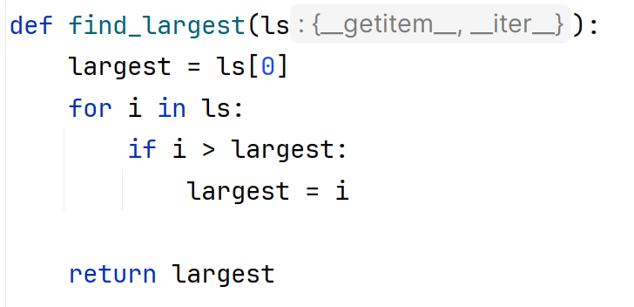
List Algorisms

Slide 18
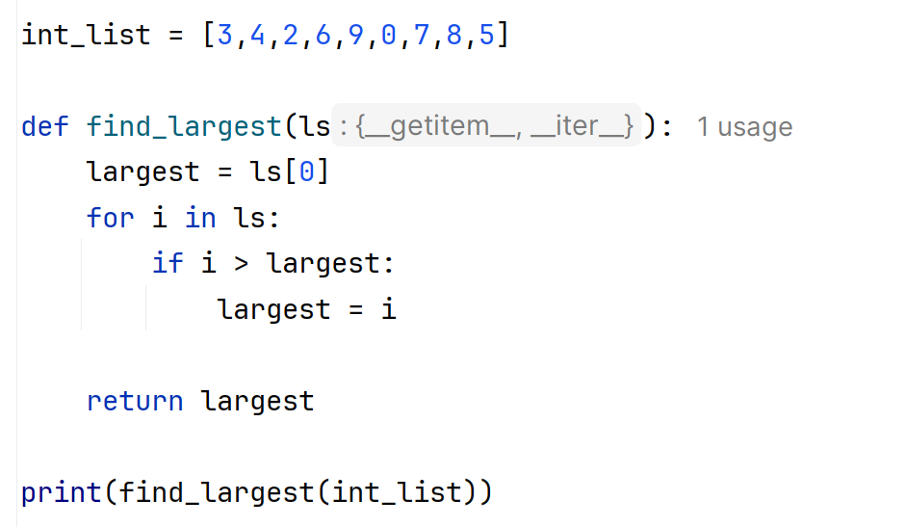
List Algorisms
This will print 9

Slide 19

List Algorisms
Exercise: write a script that finds the minimum of this list

Slide 20
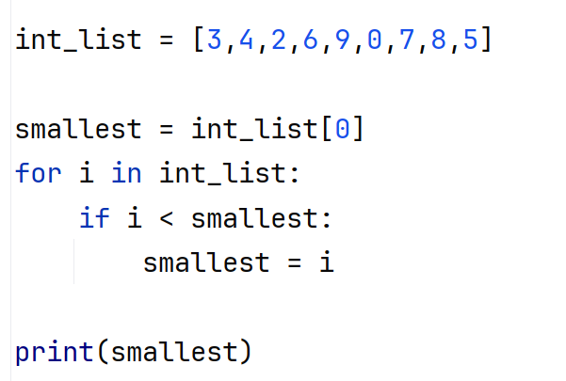
List Algorisms
Exercise: write a script that finds the minimum of this list

Slide 21
List Algorisms
Exercise: make a function that takes in a list and return the smallest number. (In other words, convert this into a function)

Slide 22
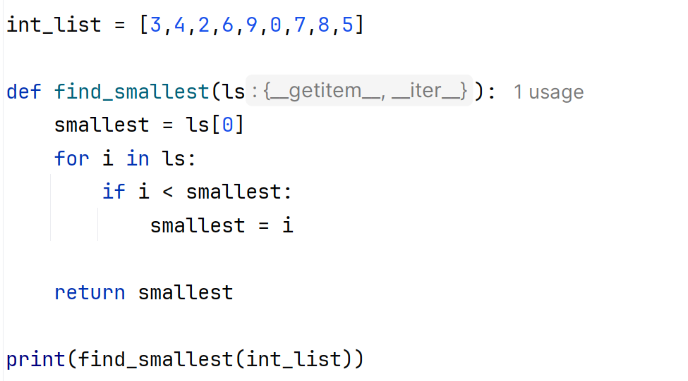
List Algorisms
Exercise: make a function that takes in a list and return the smallest number

